Slide 1

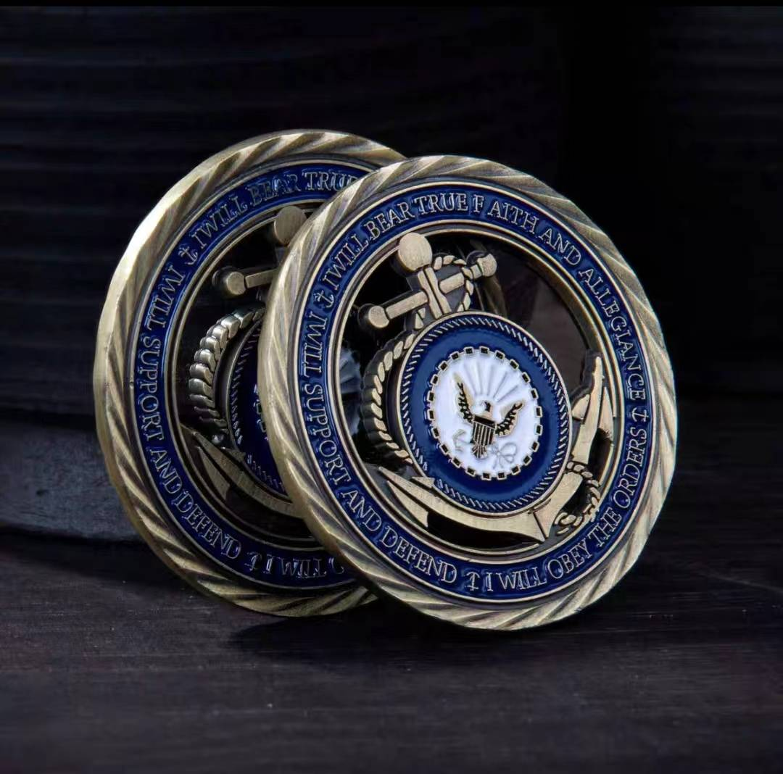
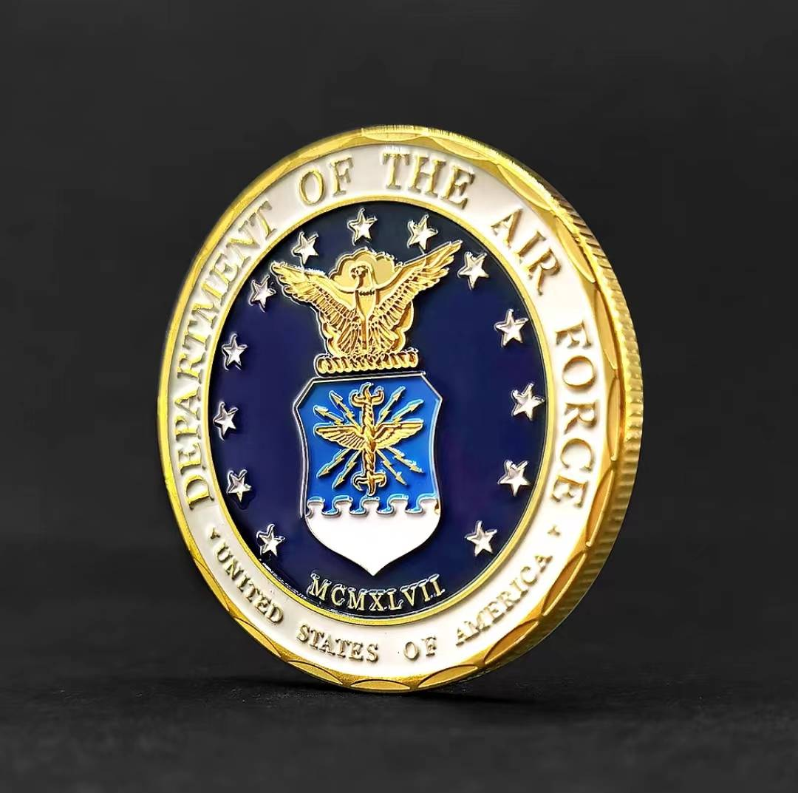

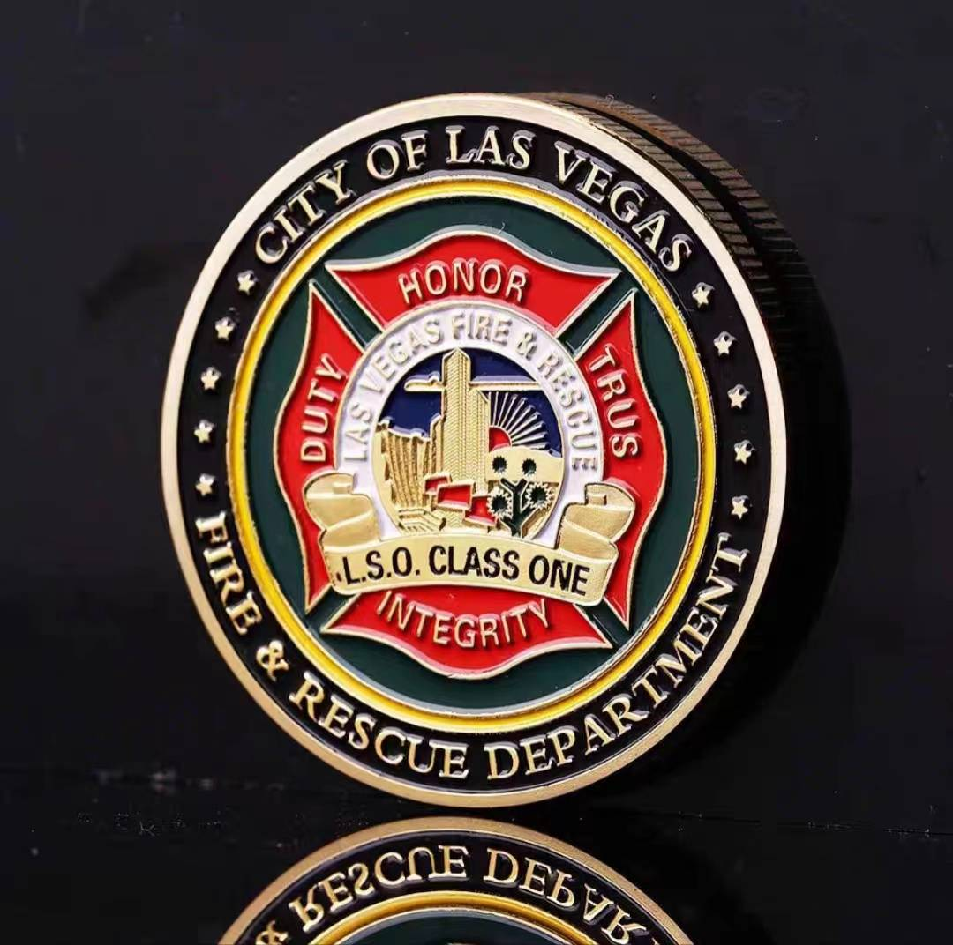
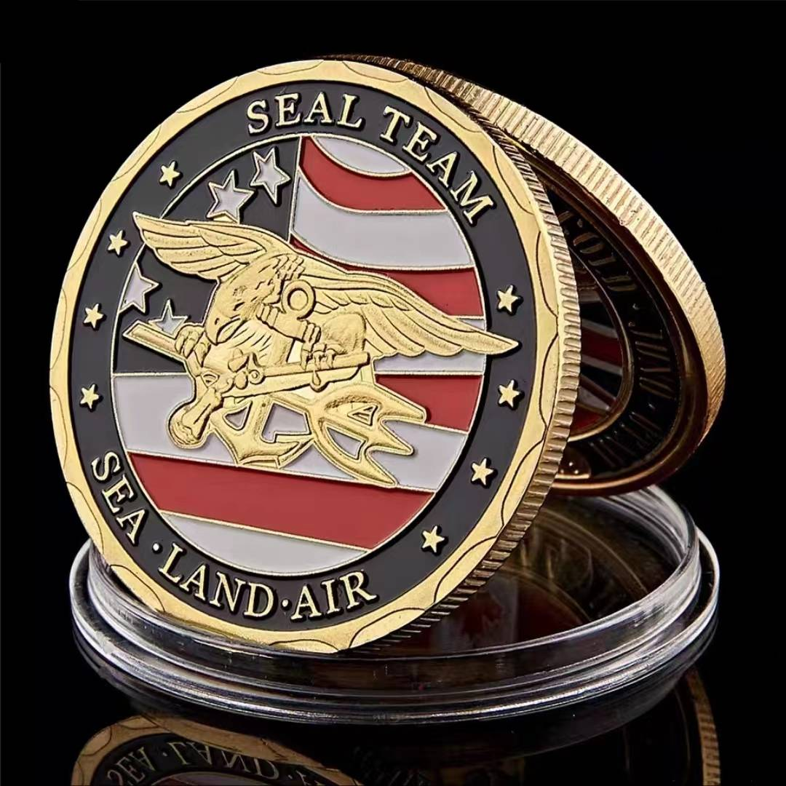
Challenge Coin Catalog

Slide 2
1
About Us
CONTENTS
2
Product Display
3
Production Process
4
  Why Choose Us

Slide 3
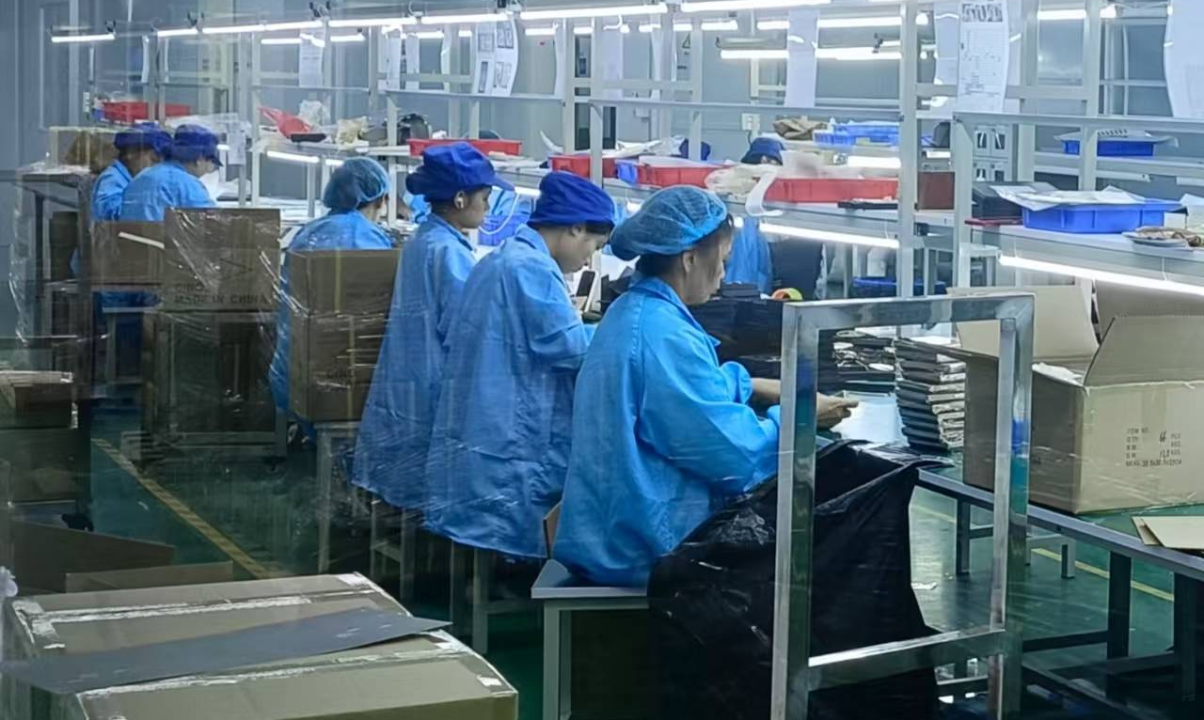
About Us
BadgeArtisans is one of the few manufacturers to have an in-house design team and has been specialising in custom gifts such as MEDALS, badges, keyrings, challenge coins, bottle openers and more since its inception in 2010.
Providing Free Design Services and One-stop Solution, we have worked with both domestic and international clients and brands, getting the trust and a good reputation.
Free Design Service
Own Factory
Authorized Certification
Personalized Customization
Complete production line
Sedex, Disney, BSCI, TUV, SGS
延迟符

Slide 4






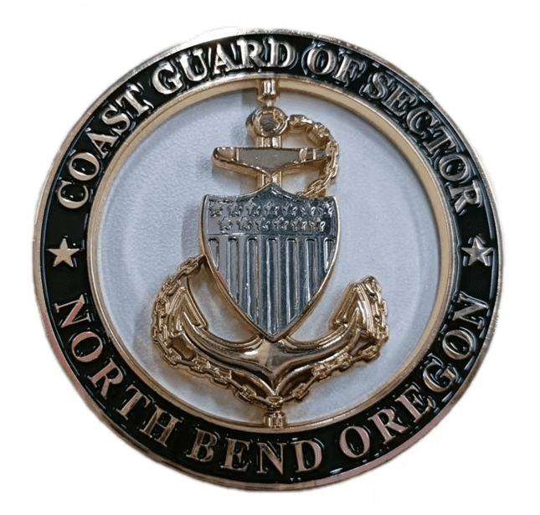
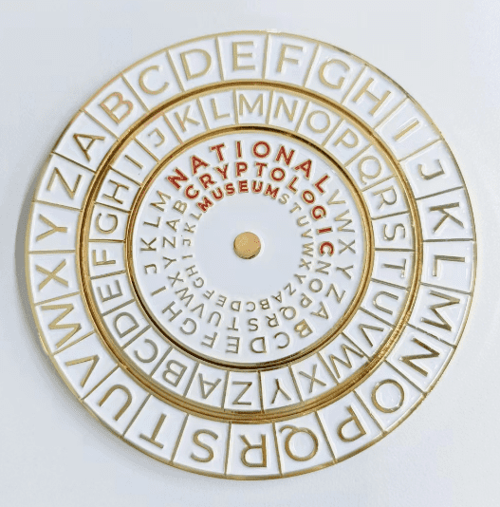


Product Display - 1
Police Coins
Military Coins
Firefighter Coins
Company Coins
Spinner Coins
Slider Coins
Air Force Coins
Army Coins
延迟符

Slide 5



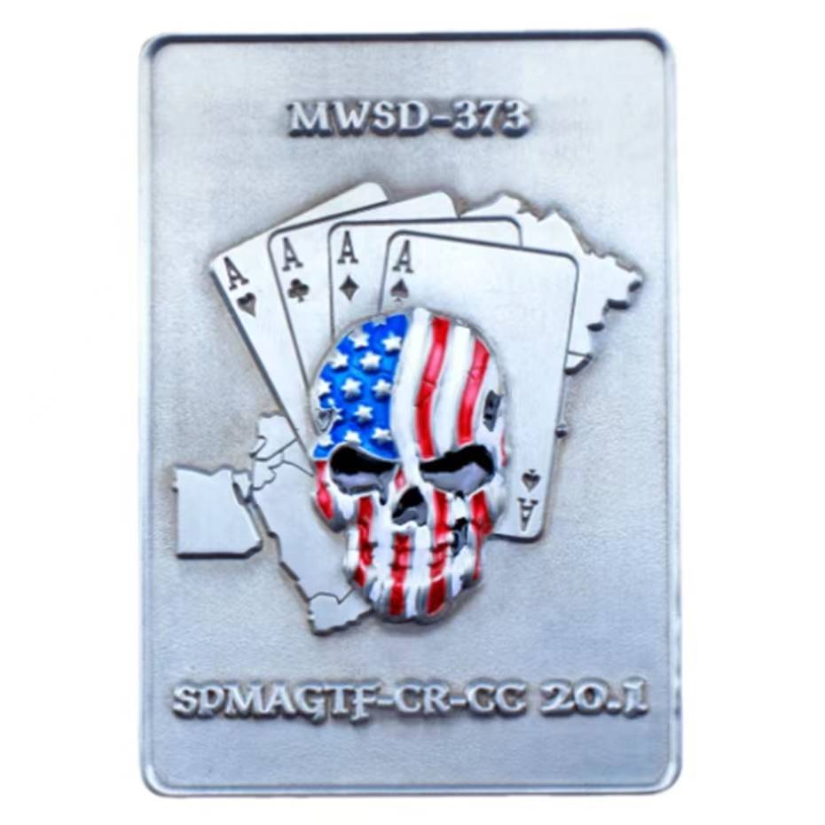

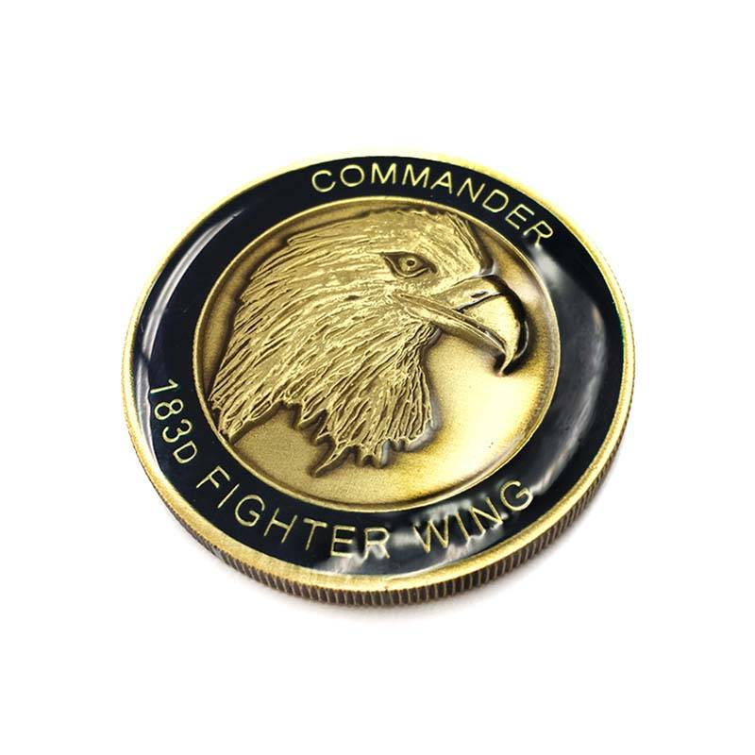


Product Display - 2
3D Coins
Marines Coins
Navy Coins
Coast Coins
Govt. Coins
School Coins
Epoxy Coins
Opener Coins
延迟符

Slide 6

Production Process - Free Design
1.Send Us Your Idears
It could be a logo, a picture, a sketch...
2.Free Challenge Coins Artwork
Our in-house team of designers will serve you for free.
3.Free Real-effect Challenge Coin
We will send the drawing to you for approval after it is completed.
延迟符

Slide 7



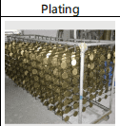
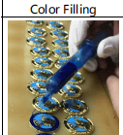
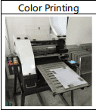

Production Process
Complete production line, strict control of product quality
延迟符

Slide 8
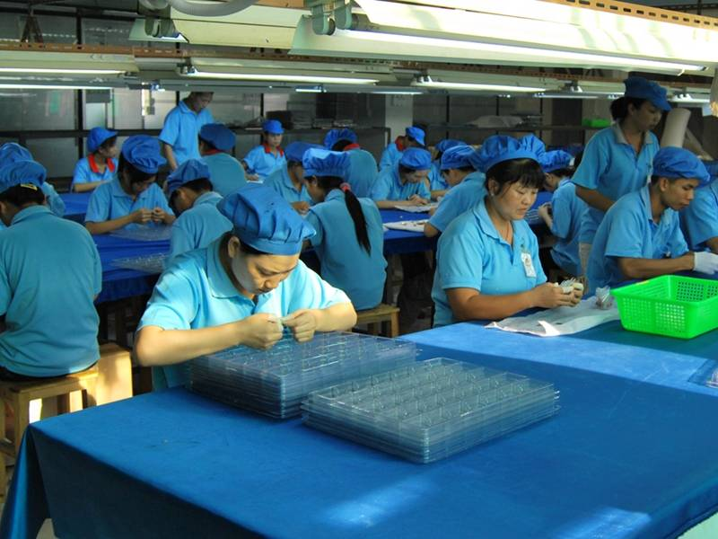
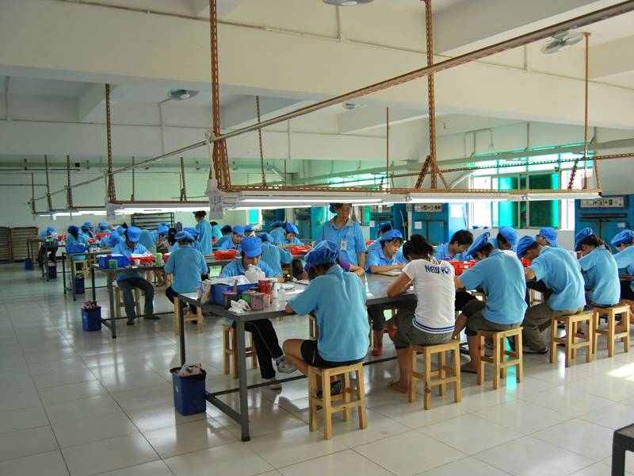
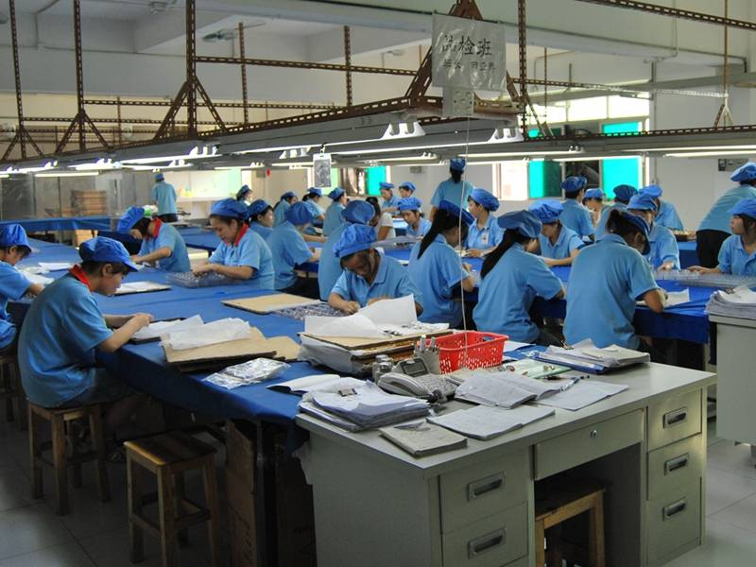
Production Process
1
2
3
The products will be inspected three times before packaging to screen out defective products and ensure that every product shipped is excellent.
延迟符

Slide 9
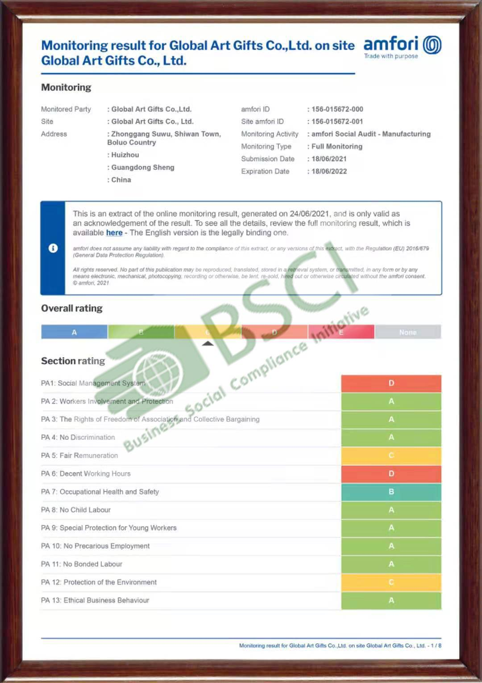
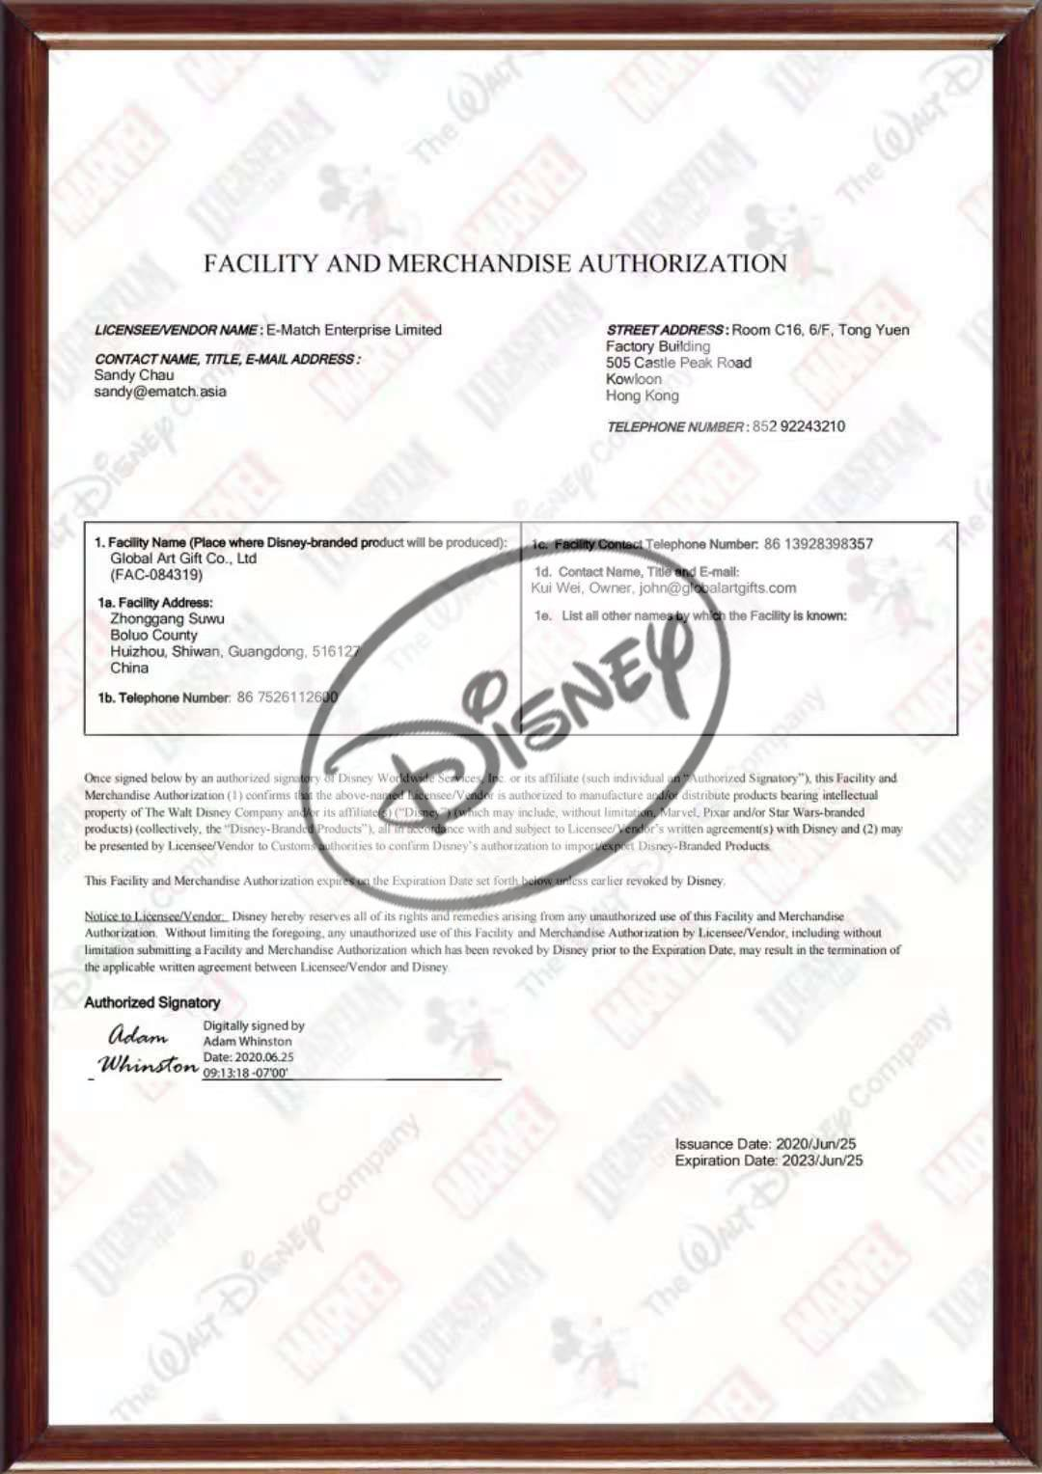

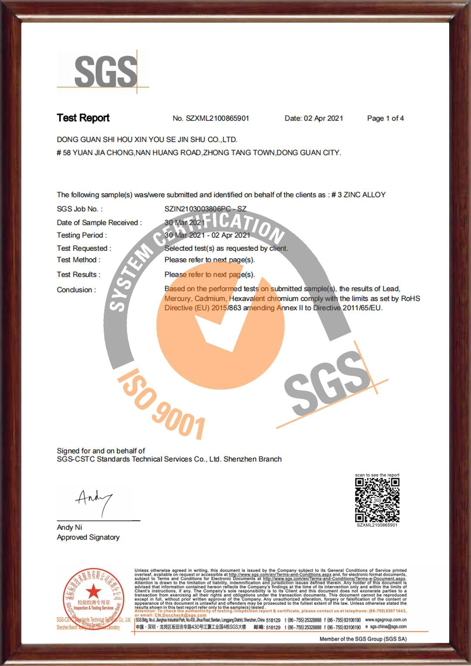

Why Choose Us - Certification
In recent years, the company has made breakthrough progress in market access and qualification certification. The certificates recently obtained by our company include:
延迟符

Slide 10
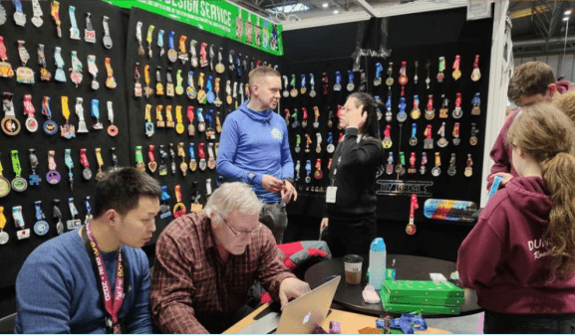
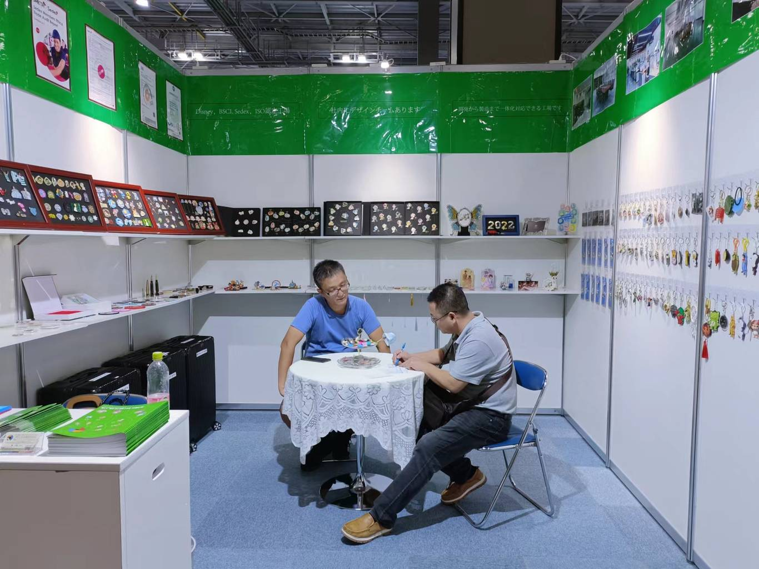
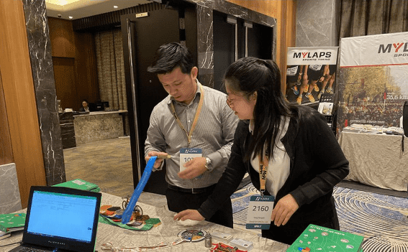
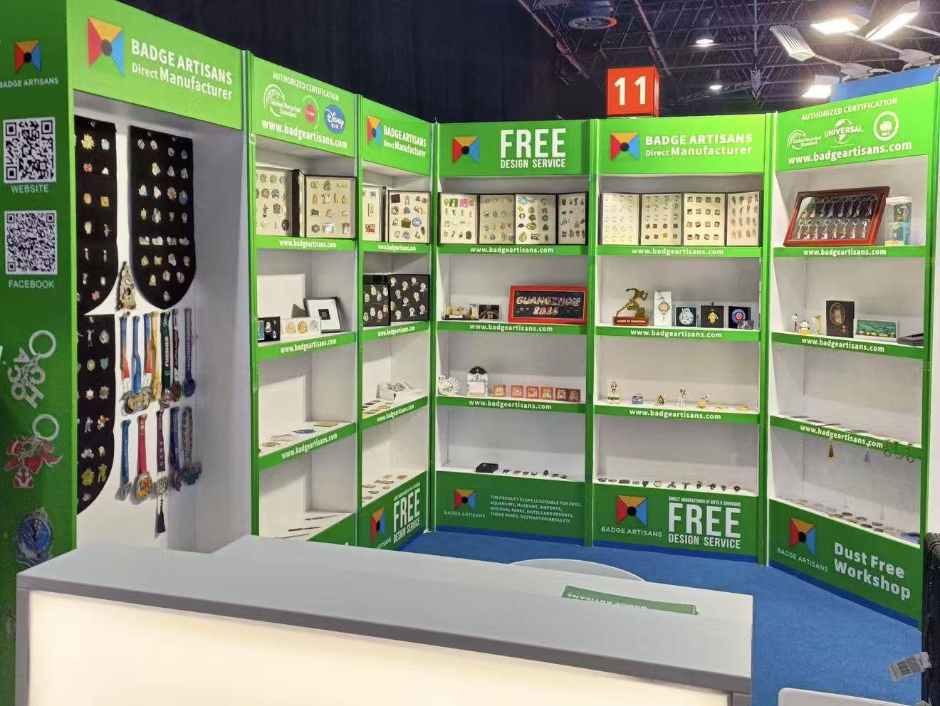
Why Choose Us - Exhibition
Malaysia
Japan
Guanghzou
Germany
延迟符

Slide 11
Why Choose Us
Other
Badge Artisans
No design team
VS
In-house Design Team
No factory of its own
Factories with complete production lines
Quality control 60%
Quality control 100%
延迟符

Slide 12
Why Choose Us
01
Free Samples
02
Free Design Artwork
SERVICE
04
Factory price
03
ODM/OEM
延迟符

Slide 13

Thanks for your time!
https://www.badgeartisans.com/
延迟符
延时符

